Slide 1

PROJECT REPORT
On
Resume Analyzer
(CSE V Semester Mini project) 2022-2023
Submitted by: Abhishek Gaira
Roll. No: 01
CSE-K-IV-Sem
Session: 2022-2023
Submitted to:
Guided by : Dr Rakesh Patra Sir
DEPARTMENT OF COMPUTER SCIENCE AND INFORMATION TECHNOLOGY
GRAPHIC ERA HILL UNVERSITY, DEHRADUN

Slide 2

What it does?
Resume parsers analyze a resume, extract the desired information, and insert the information into a database with a unique entry for each candidate.Once the resume has been analyzed, a recruiter can search the database for keywords and phrases and get a list of relevant candidates.

Slide 3
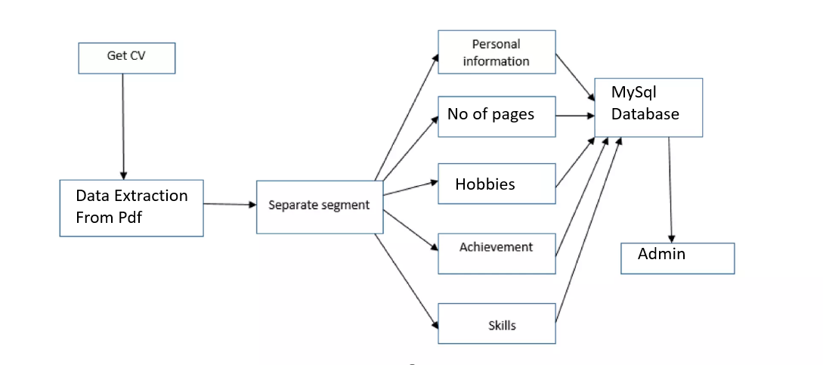
Work flow
MySql Database
No of pages
Hobbies
Data Extraction From Pdf
Admin

Slide 4
Features of this resume analyzer
Data Extraction from PDF
Data is saved on MySql Database
Candidates can upload the resume and their data will be saved
Tells admin how many fresher and experienced candidates have applied
Tells admin the field of interest of the candidates
Gives you resume score based on the content you have provided

Slide 5
What I have used(Libraries)
Streamlit for the interface
Pandas for data representation
Io for file input output operations
Resume parser for extracting data and categorizing
Image for showing image on the application
Pymysql for connecting webapp to mysql database
Plotly.express for making pie charts
Pdfminer for extracting data from pdf

Slide 6
Future work on this project
1)It will Recommended skill to candidate for particular field.
2) It will recommend videos and sample resume to candidate below a specific resume score.
3)It will recommend jobs based on your skills
4) Any links provided will also be saved( LinkedIn ,github , etc)
5) Hosting this as a website
6)the admin can select a job profile and match all resume with that and check which fits best for the job

Slide 7
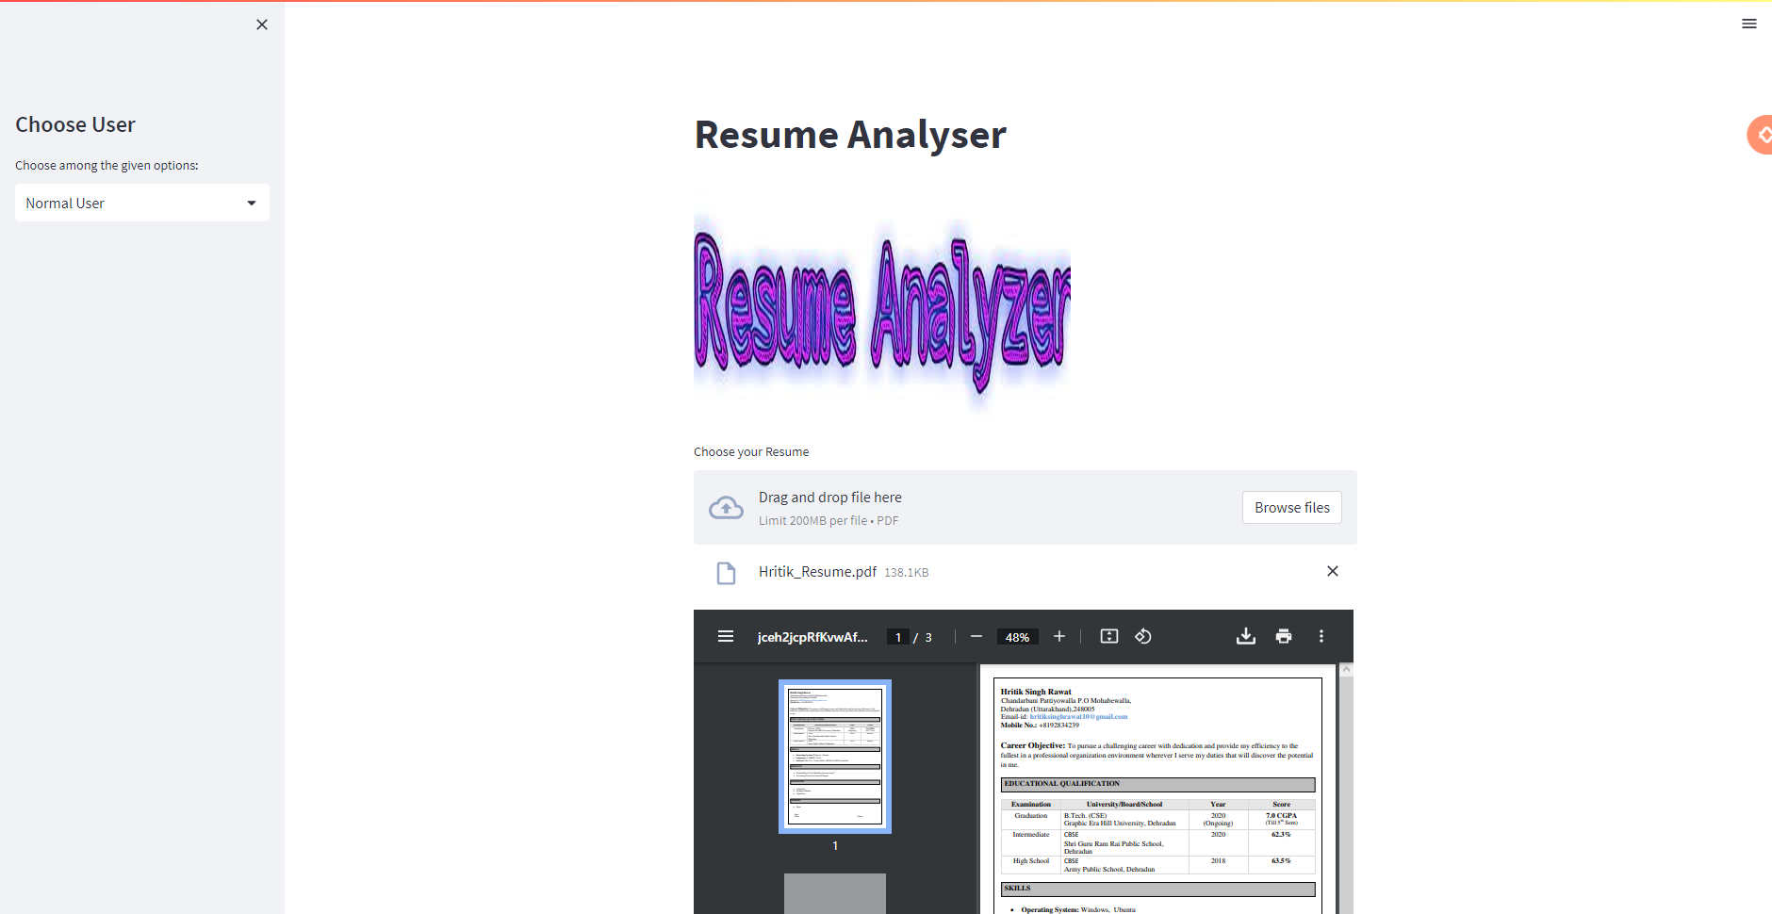
Screen shots

Slide 8
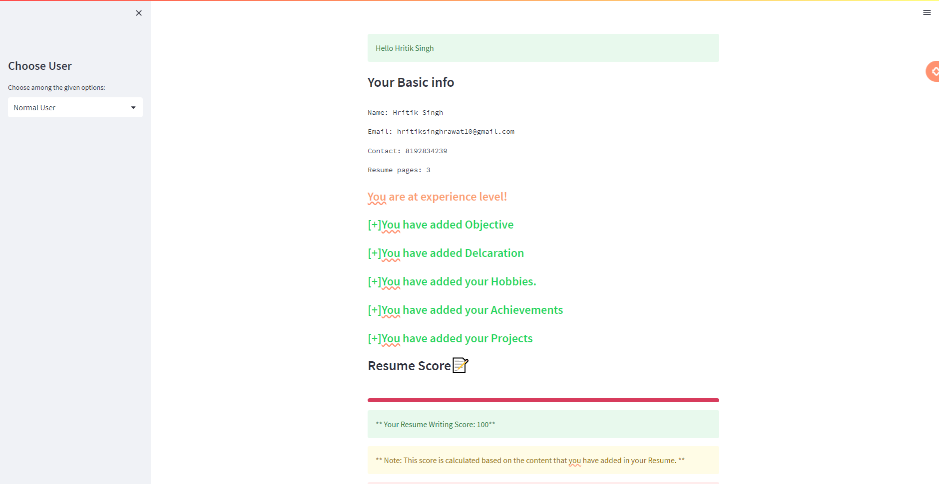

Slide 9
